Slide 1
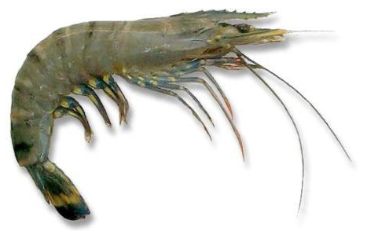
Possible Interventions and Strategies towards Growth & Sustainable Shrimp Aqyaculture Industry in North Western Province, Sri Lanka

Slide 2
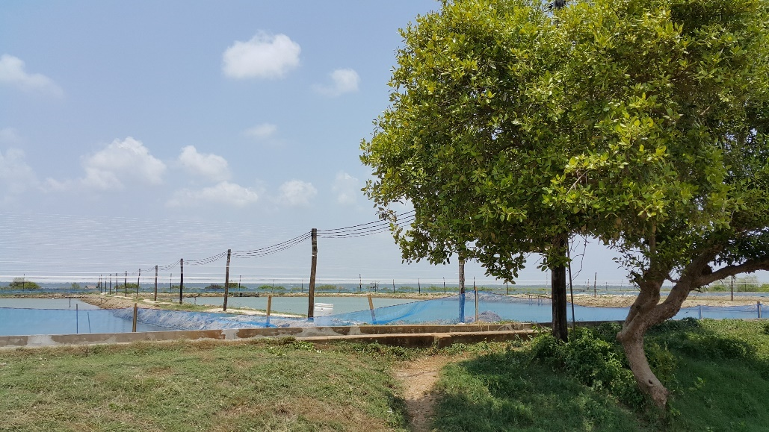
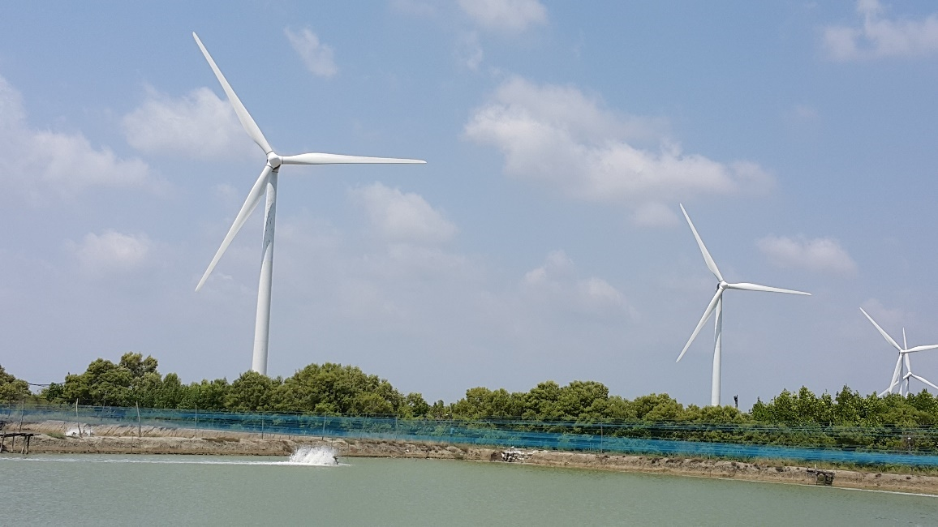
Shrimp Aquaculture
SRI LANKAN
SHRIMP AQUACULTURE
CAN PRODUCE
4,500 MT PER YEAR in NWP
EXPORTS 1500 MT PER ANNUM ?

Slide 3
Is the Present Productivity is Acceptable from the Existing Shrimp Farms?

Slide 4
NORTH WESTERN PROVINCE- Shrimp Farming Information
AREA | NO OF FARMS | NO OF PONDS | PL REQD/CORP ( Millions ) | PRODN/CROP ( MT )
ZONE 1 | 72 | 340 | 34 | 510
ZONE 2 | 299 | 1272 | 127 | 1900
ZONE 3 | 136 | 633 | 64 | 955
ZONE 4 | 25 | 205 | 20 | 310
ZONE 5 | 98 | 550 | 55 | 825
TOTAL | 630 | 3000 | 300 | 4500

Slide 5
PRODUCTIVITY ???
Total No of Ponds – 3000
Total Post Larvae per Culture – 300 Million
Targeted Production per Culture – 4500 MT
Average Targeted Production per pond – 1500 KG

Slide 6
PRODUCTIVITY ???
Total No of Ponds – 3000
No of Culture Per Year - 2
Total Production per Year – 4500 MT (Projected for 2016)
Total Production per Pond – 750 KG/Year
Success Rate in Production – 50 %
Is the Present Productivity is Acceptable from the Existing Shrimp Farms?

Slide 7
Is there any way to increase the Shrimp Productivity from the Existing Farms?
YES ? NO ?
Improve Farming System ?
Improve Hatchery System ?
Manage WSSV & MBV ?
Crop Calendar ?
BMP’s ?

Slide 8
Success Story of the Shrimp Aquaculture
NAQDA has been working with SLADA for the implementation of the following in the Shrimp Aquaculture Industry since 2004
Regularizing Shrimp farms and Hatcheries and issuing Licenses to Operate in proper manner including Grading of Shrimp Hatcheries.
ZONING the Shrimp Farming Areas and implementing CROP CALENDAR System.
Implementation of BMP’s in all the segments of the Industry and Introduced Post Larvae TRANSPORT BILL System.
Implementation of Proper Biosecurity Systems and Hi Tech PCR Laboratory System for Screening the disease causing Organisms.
Trying to arrange funds to improve the infrastructure facilities like Electricity Supply, common supply and sedimentation canals for certain clusters of shrimp farms.

Slide 9
Monthly Shrimp Production 2012

Slide 10
Monthly Shrimp Exports 2012

Slide 11
Monthly Shrimp Production & Exports 2012

Slide 12
Monthly Shrimp Production & Exports with Farm Gate Prices 2012

Slide 13
Monthly Shrimp Production 2013

Slide 14
Monthly Shrimp Exports 2013

Slide 15
Monthly Shrimp Production & Exports 2013

Slide 16
Monthly Shrimp Production & Exports with Farm Gate Prices 2013

Slide 17
Monthly Shrimp Production 2014

Slide 18
Monthly Shrimp Exports 2014

Slide 19
Monthly Shrimp Production & Exports 2014

Slide 20
Monthly Shrimp Production & Exports with Farm Gate prices 2014

Slide 21
Monthly Shrimp Production 2015

Slide 22
Monthly Shrimp Exports 2015

Slide 23
Monthly Shrimp Production & Exports 2015

Slide 24
Monthly Shrimp Production & Exports with Farm Gate Prices 2015

Slide 27
Black Tiger Shrimp Market ?
Market Growth & Development is not possible if this trend Continues in Shrimp Aquaculture Industry.

Slide 28
Monodon prices - why lower than vannamei?
Not true in all markets,
Consumers trading down from monodon to vannamei?
Monodon no longer marketed as much as before?

Slide 29
Technical/Business Reasons ?
Fluctuation of Brood Stock Supply
Poor Quality Brood Stock due to probable inbreeding.
Post larvae Produced will be lower in Quality.
More Disease Occurrence in the Farms
Low Productivity
High Production Cost
Inconsistent Supply to Export market
Fluctuation in Shrimp Prices
Under productivity from the Existing Ponds
Loss of Business Opportunities

Slide 30
What is the Solution?
Switch to Vannamei Shrimp farming.
Is it Correct? Are we in the right path?

Slide 31
Introduction
Penaeus vannamei also known as the pacific white or whiteleg shrimp is native to the Pacific coast of Mexico southward to Peru. Whiteleg shrimps occur in tropical marine areas with water temperatures normally higher than 20ºC throughout the year. They are highly euryhaline and can withstand salinities ranging from 0 to 55ppt. Adults live and spawn in the open ocean whereas postlarvae migrate inshore to spend their juvenile, adolescent and sub-adult stages in coastal estuaries, lagoons or mangrove areas.

Slide 32
Taxonomic Classification
Kingdom: Animalia
Phylum: Anthropoda
Subphylum: Crustacea
Class: Malacostraca
Subclass: Eumalacostraca
Order: Decapoda
Suborder: Dendrobranchiata
Superfamily: Penaeidae
Family: Penaeidae
Genus: Penaeus
Species: Vannamei

Slide 33
Biological Features
Rostrum moderately long with 7-10 dorsal and 2-4 ventral teeth.
In mature males petasma symmetrical and semi-open.
Spermatophores complex, consisting of sperm mass encapsulated by sheath. Mature female has open thelycum.
Maximum size 23 cm, with maximum CL of 9 cm.

Slide 34
Biology
Males become mature from 20g and females from 28g onwards at the age of 6-7 months
P. vannamei weighing 30-45g will spawn 100-250,000 eggs of approximately 0.22mm in diameter.
Hatching occurs about 16hrs after spawning and fertilization.

Slide 35
Site Selection
Topography and Climate Condition
Topographically, the best areas for shrimp culture are those with average natural ground elevations of about 1-3 m above mean sea level or at least 1 m above the highest high tide level to allow drainage and harvesting.
The sites should have minimum vegetative cover, be near the sea or other natural waterways such as rivers and streams, have easy access to roads, a sparse population and be nearly square or rectangular in shape.

Slide 36
In terms of climatic conditions, areas having short and not as pronounced a dry season with moderate rainfall distributed throughout the year are the best suited for shrimp farming. A pronounced long dry season may cause an increase in water temperature and salinity, which will promote excessive growth of algae and result in oxygen depletion at night.

Slide 37
Infrastructure
Accessibility
The farm must have good accessibility either by road or water, and communication systems throughout the year in order to facilitate supervision and transport of materials and products.
It is important that the farm be within 3-6 hrs traveling time from the hatchery to avoid excessively long transportation time of the larvae and should be within 10 hrs from the processing plant to avoid deterioration of the product

Slide 38
Electricity
Availability of relatively cheap and reliable power source is a major consideration in site selection. In areas where electricity supply exists, it is practical and beneficial to utilize electric power to run the farm, especially for the intensive culture system. It is advisable to have a back-up electricity generator as a secondary power source.

Slide 39
Security
Areas free from security risks result in favorable working conditions, productivity and less extra costs.
Availability of Labor and Other Factor
-The availability of labor, equipment and commercial feed and supplies ensure smooth operations and successful crop.

Slide 40
Water Supply
Site should have good pollution free water supply of both freshwater and brackish water.
Soil Conditions
- The type of soil is the most critical in site selection, since the shrimp will spend most of their time on the pond bottom during the culture period. Usually, clay or loam-based soil containing more than 90% clay and pH between 6.5-8.5 is preferable.

Slide 41
Special Features of Vannamei Shrimp Farming
Growth Rate
Stocking Density
Salinity Tolerance
Temperature Tolerance
Dietary Protein Requirements
Ease of Breeding and Domestication
Larval Rearing
Disease Resistance
Post Harvest Characteristics

Slide 42
Growth Rate
P. vannamei can grow as fast as P. monodon up to 20 g and typically grows faster (1-1.5 g/wk) than P. monodon (1 g/wk) currently in Asia. Size range on harvest generally smaller.

Slide 43
Stocking Density
Penaeus vannamei are amenable to culture at very high stocking densities of up to 150/m2 in pond culture, and even as high as 400/m2 in controlled recirculated tank culture. Although such intensive culture systems require a much higher degree of control over environmental parameters, it enables the production of high numbers of shrimp in limited areas, resulting in better productivity per unit area than that currently achievable with P. monodon in Asia.

Slide 44
Salinity Tolerance
Penaeus vannamei tolerates a wide range of salinities, from 0.5-45 ppt, is comfortable at 7-34 ppt, but grows particularly well at low salinities of around 10-15 ppt (where the environment and the blood are isosmotic).

Slide 45
Temperature Tolerance
P. vannamei will tolerate a wide range of temperatures, but it grows best between 23-30ºC. They will also tolerate temperatures down to 15ºC and up to 33ºC without problems. Penaeus vannamei can thus be profitably cultured during the cool season in Asia (October-February). This is traditionally the low season for P. monodon farmers in this part of the world, meaning that increased yearly harvests may be possible using these alien species. This greater temperature tolerance of P. vannamei may also be a reason why farmers have perceived this species to be more resistant to WSSV relative to P. monodon. However, recent experience in Thailand, Ecuador and elsewhere has shown that when water temperatures decline to less than 30ºC, increased problems with viral diseases such as WSSV and TSV occur not just with P. monodon, but equally with P. vannamei.

Slide 46
DIETARY PROTIEN REQUIREMENT
P. vannamei requires a lower protein (and hence cheaper) diet (20-35 percent) during culture than P. monodon, and are more able to utilize the natural productivity of shrimp ponds, even under intensive culture conditions. In Thailand for example, current grow-out feeds for P. vannamei contain 35 percent protein and cost 10-15 percent less than the 40-42 percent protein feeds for P. monodon. Additionally, feeding efficiency is better with P. vannamei, which yield an average FCR of 1.2, compared to 1.6 for P. monodon. These factors, together with higher growth and survival rates are responsible for the 25-30 percent lower production costs for producing 20 g of P. vannamei than P. monodon.

Slide 47
Ease of Breeding & Domestication
P. vannamei is an open thelycum species, meaning that they can be induced to mate and spawn easily in captivity (unlike the closed thelycum P. monodon) which enables the culturist to close the life cycle of the shrimp, facilitating genetic selection (i.e. for improved growth rate and disease resistance) and domestication programmes. This feature permits much more control and enhancement of the cultured stock and allows the development of SPF and SPR stocks, which are already commercially available. This in turn relieves the expense, disease implications, environmental concerns, unpredictability and waste of relying on wild broodstock

Slide 48
Larval Rearing
Larval survival rates during hatchery rearing are generally higher (60-70 percent) with P. vannamei than with P. monodon (40-50 percent)

Slide 49
Disease Resistance
Penaeus vannamei is generally considered to be more disease resistant than other white shrimp.
Penaeus monodon is generally regarded as being highly susceptible to both WSSV and YHV, but not to IHHNV or TSV.

Slide 50
Post Harvest Charesteristics
After harvest, if well treated with plenty of ice, P. vannamei are particularly resistant to melanosis and keep a good appearance three to four days after defrosting. However, P. monodon tend to have a longer shelf life and are easier to handle, transport and process than P. vannamei.

Slide 51
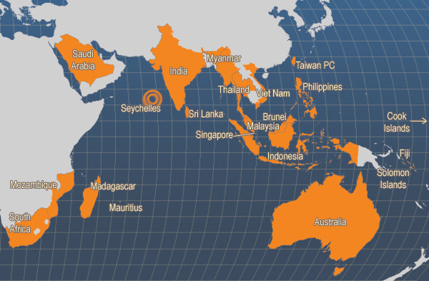
Main producer countries of Penaeus monodon (FAO Fishery Statistics, 2006)

Slide 52
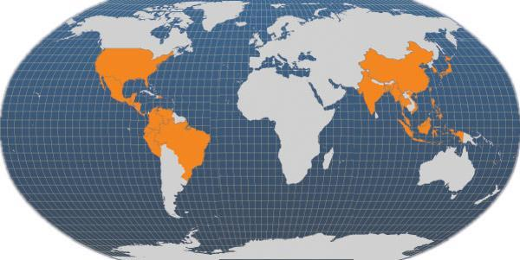
Main producer countries of Penaeus vannamei (FAO Fishery Statistics, 2006)

Slide 53
Why we have not Introduced Vannamei Earlier?
Disease Threat
Infrastructure & Quarantine facilities
Insufficient Management and Monitoring System
Technology Implementation
High Hope with Monodon.

Slide 54
How it is Proposed to Introduce Vannamei?
Select 500 Ponds in NWP
Stocking Density 50 PLs per Square Meter
Average Size at Harvest 20 grams
Expected Survival: 80%
Expected production: 4000 per Crop/Pond
Culture period : 120 Days
No of Crops per Year: 02
Production per Crop: 2000 MT
Annual production: 4000 MT

Slide 55
How it is Proposed to Introduce Vannamei?
Total Post Larvae for one Crop: 125 Mn
Total Post larvae for one Year: 250 Mn
No of Hatcheries: 5 to 8
They will be allowed to Import SPF Brood Stock from Certified suppliers.
PL Production will be regulated to stagger the stocking to get the continues production.

Slide 56
How it is Proposed to Introduce Vannamei?
Av. Vannamei Production per day: 12 MT
Av. Monodon production per day: 12 MT
Expected Local Supply per day: 12 MT
Expected Export Supply per day: 12 MT
Available Processing Capacity/Day: 40 MT
Excess Processing Capacity: 28 MT
( Assumed 50%Production will go to Local market)

Slide 57
How it is Proposed to Introduce Vannamei?
If the First Phase Successful with 500 ponds the other phases can be implemented with 500 ponds each.
The Whole NWP is converted in Six phases the following outcome is expected

Slide 58
How it is Proposed to Introduce Vannamei?
Total Production per Year: 24,000 MT
Av Production per Pond: 4000 MT per Crop
Total Post larvae Requirement: 1500 Mn
Each Hatchery will Produce: 40 Mn/Year
Each Farmer will produce: 40 MT/Year
Local Market will Receive: 30 MT/Day
Processors & Exporters will get 50 MT/Day
( Assumed 40%Production will go to Local market)

Slide 59
Do We Have The Proper Business Environment?

Slide 60
BUSINESS ENVIRONMENT
ECONOMIC
TECHNOLOGICAL
SRI LANKAN
SHRIMP AQUACULTURE
LEGAL
ENVIRONMENT
SOCIO POLITICAL

Slide 61
Growth of Sustainable Aquaculture Industry, Possible If We
PLAN THE FARMING CONSIDERING THE CARRYING CAPASITY OF THE NATURAL RESOURCES.
FOLLOW THE REGULATORY PROCEDURES
USE PROPER TECHNOLOGY
FOLLOW THE BETTER MANAGEMENT PRACTICES (BMP’S)
INCLUSIVE AND ENVIRONMENTALLY RESPONSIBLE MANNERS

Slide 62
Shrimp Aquaculture
GROWTH
Will Reflect All the
Value Chain Segments
of the
Industry

Slide 63
AQUACULTURE VALUE CHAIN SEGMENTS
HATCHERIES
Produce Larval, Juvenile Fish and Shellfish for Transfer to Aquaculture Facilities where they are Grown to harvest Size
EQUIPMENTS AND TECHNILOGIES
These are Tanks, Ponds, Nets, Pumps, Aerators and Other Equipment and the Technologies for the Management of Aquaculture Units
FEED AND NUTRITION
Production and Supply of Feeds and Feed Additives for the Aquaculture Sector
GROW OUT FACILIITIES
Fish and Shellfish are Raised with Sustainable Practices
PROCESSING AND DISTRIBUTION
Businesses can also create value in Aquaculture through the processing and /or distribution of Seafood Products

Slide 64
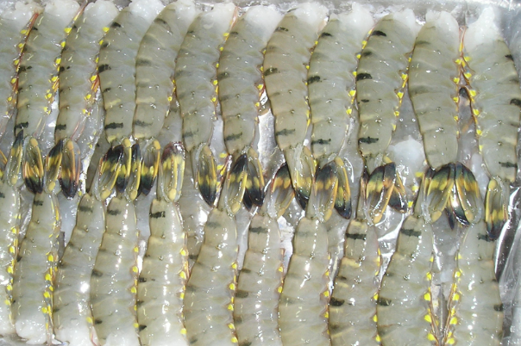
SURPRISING ?
POSSIBLE EXPECTED GROWTH IN
5 YEARS – 300 to 500%

